Slide 1


Money Transfer Application
“Your Project Name”
Task - 1

Slide 2


Money Transfer Application System
The software system being produced is called Money Transfer Application System or MTAS. It is being produced for customer who can transfer money through online at anytime and anywhere.
LMS Username | Name | Batch
2115a648 | Saran Nithish NA | A6
2115a649 | Shyam Ganesh J | A6
2115a644 | Sakthi Murugan V | A6
2115a646 | Sanjai Kumar B | A6

Slide 3
1 Introduction
The Software Requirements Specification is designed to document and describe the agreement between the customer and the developer regarding the specification of the software product requested. Its primary purpose is to provide a clear and descriptive “statement of user
requirements” that can be used as a reference in further development of the software system. This document is broken into a number of sections used to logically separate the software requirements into easily referenced parts.
1.1 Purpose
Defining and describing the functions and specifications of the Money Transfer Application System is the primary goal of this Software Requirements Specification (SRS). This Software Requirements Specification illustrates, in clear terms, the system’s primary uses and required functionality as specified by our customer

Slide 4
1.2 Scope
The scope of a money transfer application system would typically involve the development of a software application that allows users to send and receive money electronically. Such systems would typically integrate with banks and other financial institutions to ensure secure and reliable money transfer transactions.
Some potential features that could be included in a money transfer application system might include:
1.User registration and profile management.
2.Secure login and authentication.
3.Integration with banking and financial institutions for fund transfer
4.A dashboard to manage and monitor transaction history.
5.Notification and alerts on transactions, account balance and other account activity.
The scope of a money transfer application system would depend on the requirements of the organization developing the system, as well as the needs of its intended users. With the growing trend towards digital payments, there is a significant market for such systems, and they can be useful for individuals, businesses, and financial institutions alike.

Slide 5
1.3 Organization
This Software Requirements Specification document is divided in to multiple subsections. The first section includes explanations of the Purpose, Scope and Organization of the document. The first section also handles the description of project specific words, acronyms and abbreviations that will be used in the document. The second section of the document is separated into the following five different sections, each detailing specific details of system uses and their corresponding actions: Product Perspective, Product Functions, User Characteristics, Constraints, Assumptions and Dependencies, Apportioning of Requirements. The third section is an enumerated listing of all of the requirements described for this system. The fourth section encompasses all of the Use-case, Sequence, State and Class diagrams that model the system. In the fifth section there exists a Prototype of the system along with a sample scenario that graphically describes the use of the system. The sixth section contains a listing of all related reference materials used in this document. The seventh and final subsection is dedicated to providing a point of contact for any viewer of this document.

Slide 6
Description
This section includes details about what is and is not expected of the system in addition to which cases are intentionally unsupported and assumptions that will be used in the creation of the system
2.1 Constraints
While a money transfer application system can offer many benefits and conveniences, there are also several potential constraints that should be considered when developing such a system. Here are some of the most common constraints:
1.Security: The security of the system is a significant constraint, as it involves handling financial transactions and sensitive user data. Robust security measures need to be in place to protect user data and prevent fraud.
2. Network Connectivity: The system needs to be designed to work in areas with different levels of internet connectivity, as well as for users with different devices and operating systems.
3. Scalability: The system must be designed to handle large volumes of transactions and accommodate growth in the number of users, without any compromise on performance.

Slide 7
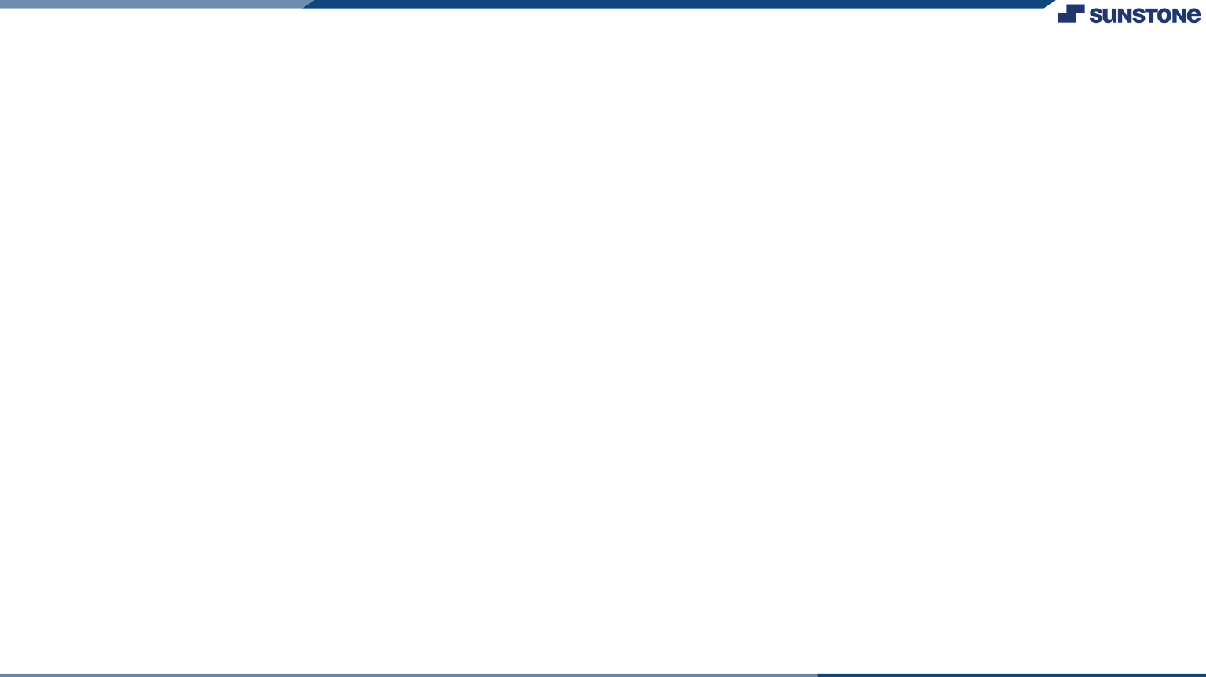

Task - 1
Creation of SRS & Github
Create SRS : “Money Transfer Application System”
Creation & Set-up of Github account
Creation & Hands-on to various commands of Git Bash
Evaluation Metric:
100% Completion of the above tasks
Learning Outcome
Get to know about different lifecycle models.
Understanding importance and how to create an SRS
Knowing various commands of Github
Understanding agile and scrum management techniques for efficient product development

Slide 8
S R S for “Money Transfer Application System"
Functional Requirements :
1.User registration: The system should allow users to register their account by providing personal details, contact information and necessary identification documents.
2. Fund transfer: The system should allow users to transfer funds to other users, which includes bank account number, transfer amount, currency type, and recipient details.
3.Account management: The system should provide a user-friendly dashboard for users to view account balance, transfer history, and manage their personal information and settings.
4. Transaction history: The system should maintain a record of all transactions made by the user, with details such as date, time, amount, currency, and other relevant information.
5. Customer support: The system should provide customer support services to help users with any issues .

Slide 9
S R S for “Money Transfer Application System"
Non-Functional Requirements :
Security: The system should have strong security features to protect sensitive user information and financial transactions, including encryption, authentication, and authorization.
Performance: The system should have fast response times and be able to handle a high volume of transactions simultaneously without any slowdowns or downtime.
Scalability: The system should be designed to handle a large number of users and transactions, with the ability to scale up or down as needed.
Availability: The system should be highly available, with a minimum of downtime or maintenance periods, in order to minimize disruptions to users.
Support: The System should provide adequate support to the users through customer support team.
Compliance: The system should be compliant with local and international regulations, such as data privacy laws, anti-money laundering laws, and other financial regulations.

Slide 10
S R S for “Money Transfer Application System"
SOFTWARE REQUIREMENTS:
1. Operating System: The system should be compatible with popular operating systems such as Windows, macOS, iOS, and Android, in order to provide access to a wide range of users.
2. Web Server: The system should run on a web server that can handle a high volume of traffic and provide fast response times.
3. Database Management System: The system should use a database management system to store user information, transaction history, and other relevant data.
4. Application Framework: The system should use an appropriate application framework that can facilitate rapid development, provide built-in security features, and help with scalability.
5. APIs: The system should have APIs available for integration with third-party services or applications, such as accounting software or e-commerce platforms.
6. Encryption: The system should use encryption technology to protect sensitive user data and financial transactions, such as SSL/TLS encryption and secure hashing algorithms.

Slide 11
S R S for “Money Transfer Application System“
HARDWARE REQUIREMENTS:
1. Processor: The system should have a powerful processor to handle a high volume of transactions and user requests simultaneously.
2. RAM: The system should have sufficient RAM to handle the load of multiple users and transactions, with a recommended minimum of 8GB.
3. Storage: The system should have adequate storage space to store user data, transaction history, and other relevant information, with a recommended minimum of 500GB.
4.Network Interface: The system should have a fast and reliable network interface to ensure fast data transfer between the system and other devices, with a recommended minimum of 1 Gbps.
5. Load Balancer: The system should have a load balancer to distribute the load across multiple servers and ensure that the system can handle a large number of users and transactions.

Slide 12
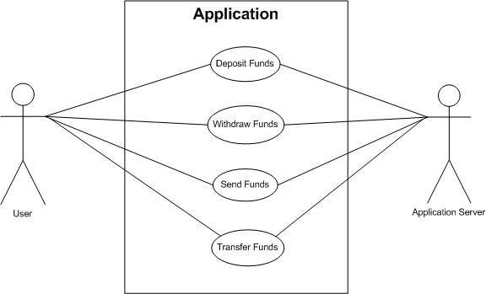
Use Case Diagram

Slide 13
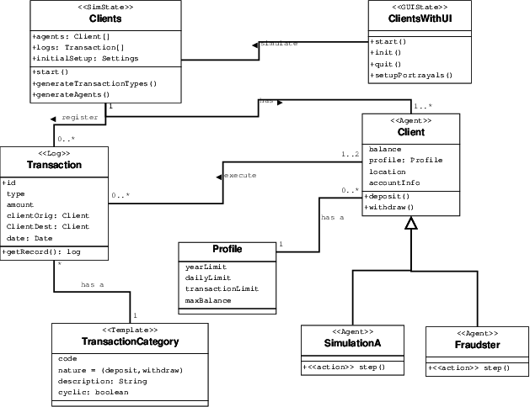
Class Diagram

Slide 14
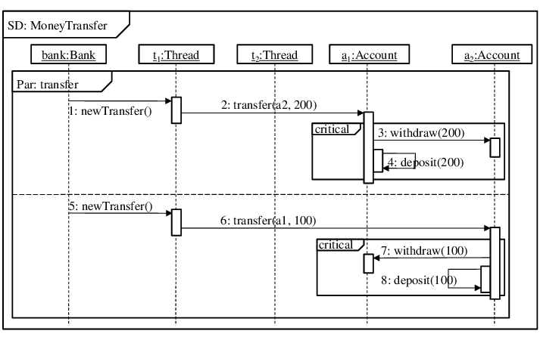
Sequence Diagrams

Slide 15
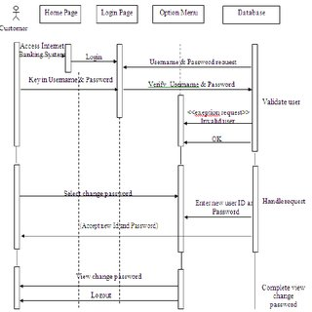

Slide 16
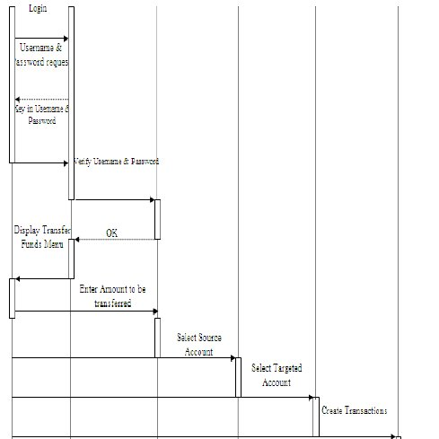

Slide 17
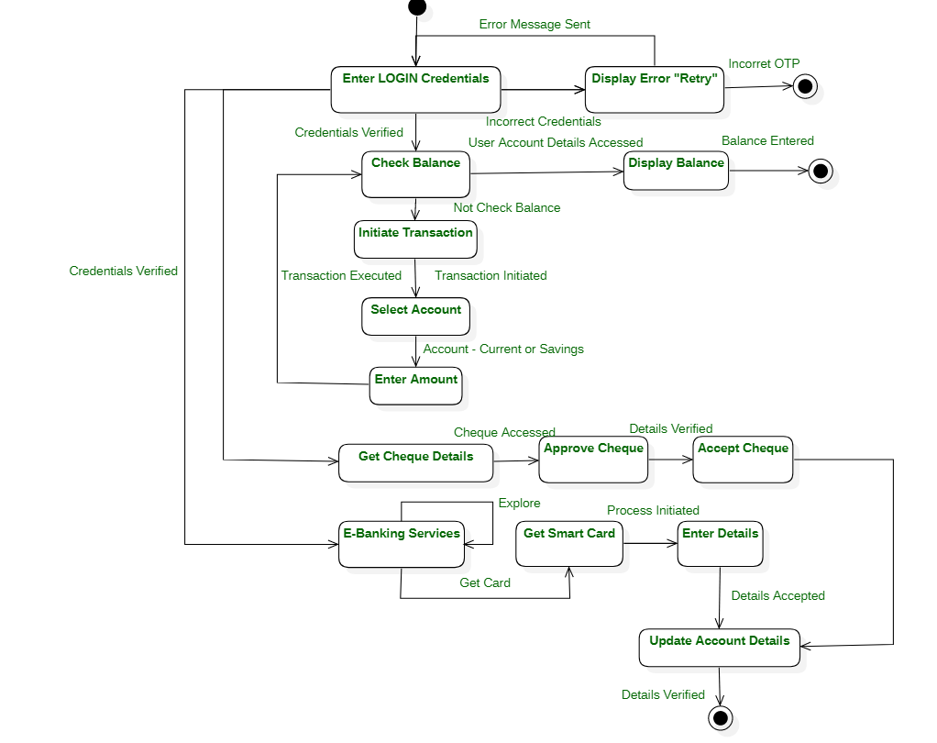
State Diagrams

Slide 18
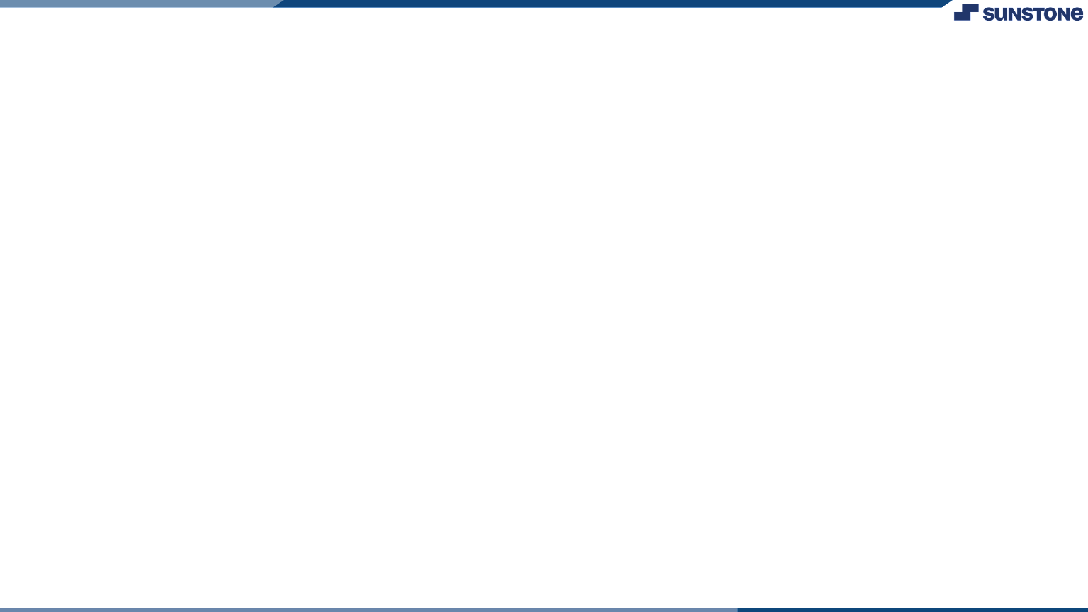
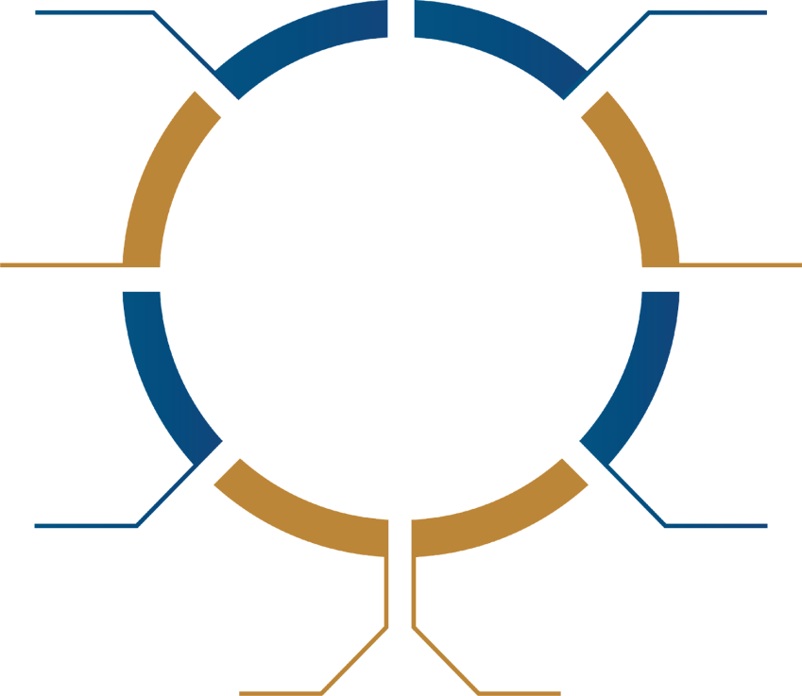
Assessment Parameter
Gather requirements for the
project
add Readme.md file with description of the project
Prepare database design
schemas
Check-List
Commit all changes with "first commit"
Get your initial project
Structure ready
create arepository on github
realted to project
Initiate agit repository
Push your changes to github

Slide 19
https://github.com/12345venkat/ fullstack
Submission Github

Slide 20


